Slide 1
CONTENTS
ABSTRACT
INTRODUCTION
KEY FEATURES
SENSORS
MICROCONTROLLERS
BLOCK DIAGRAM

Slide 2
ABSTRACT
The Arduino-based IoT home security system combines sensors like gas, temperature, and infrared to address thefts, fire, and gas leaks. Linked to an Arduino Uno processor and an ESP8266 Wi-Fi module, the system detects and communicates incidents promptly.
The inclusion of an LDR enhances security by identifying energized lamps or fire flames. Activating before locking, the system employs IR sensors to detect tampering, triggering alarms.
This integrated approach ensures comprehensive protection, sending real-time alerts and empowering homeowners to secure their houses effectively against a range of potential threats.

Slide 3
INTRODUCTION
Integrated Sensors:
Our project uses Arduino Uno and IoT technology, integrating gas, temperature, light, and IR sensors for comprehensive home security. Intelligent sensor fusion ensures accurate threat detection.
Instant Wi-Fi Connectivity:
With an ESP8266 Wi-Fi module, our system provides real-time connectivity, enabling immediate alerts for swift responses to potential threats.

Slide 4
Key Features
Our IoT-based home security system is designed to provide comprehensive protection for homes. Utilizing Arduino Uno and ESP8266, it integrates gas, IR, temperature, and light sensors for thorough monitoring.
With the ability to detect gas leaks, unauthorized entries, and fire traces, the system ensures prompt response to potential threats. Real-time data transmission via Wi-Fi enables instant alerts to the user, enhancing security measures.
Additionally, the system features a pre-arming function that activates before locking the main door, further fortifying defense mechanisms. Its user-friendly interface and intuitive design make it accessible to homeowners, offering peace of mind and a sense of security.
By leveraging advanced sensor technology and IoT connectivity, our home security system provides a reliable and efficient solution to safeguard homes from various incidents, contributing to a safer living environment for residents.

Slide 5
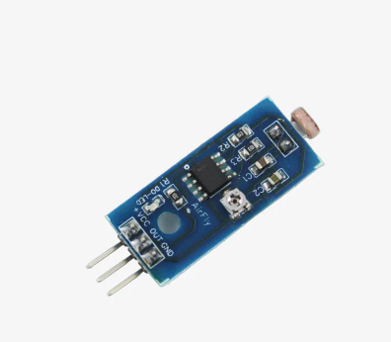
SENSORS
Light Dependent Resistor (LDR)
The Light Dependent Resistor (LDR) in your system measures light intensity. It is sensitive to variations in light levels, detecting changes caused by energized lamps or flames, enhancing the home security system's ability to identify potential threats.
LDRs are typically made of semiconductor materials, such as cadmium sulfide (CdS). The conductivity of these materials changes with light exposure.

Slide 6
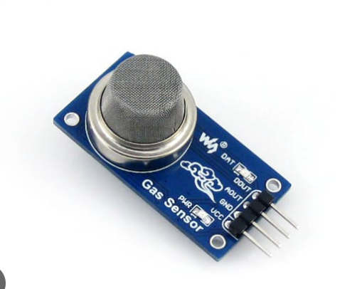
MQ2
The MQ2 gas sensor is a semiconductor sensor that can detect a variety of gases and smoke in the air, including:
Liquefied natural gas (LNG), Butane, Propane, Methane, Alcohol, Hydrogen, and Carbon monoxide.

Slide 7
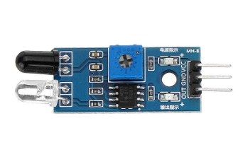
IR Sensor
IR (Infrared) sensors are strategically placed near the main door to detect unauthorized entry attempts. When the infrared beams are interrupted, these sensors trigger alarms, enhancing the security system's capability to thwart potential intruders.
An IR sensor consists of two main components – an infrared emitter and an infrared receiver. The emitter emits infrared light, and the receiver detects the reflected or emitted infrared radiation.

Slide 8
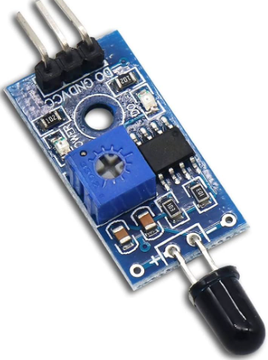
FLAME SENSOR
A flame detector is a type of sensor that can detect and respond to the presence of a flame. These detectors have the ability to identify smokeless liquid and smoke that can create open fire.
For example, in boiler furnaces flame detectors are widely used, as a flame detector can detect heat, smoke, and fire

Slide 9
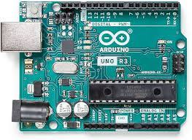
MICROCONTROLLERS - Arduino Uno
The microcontroller, such as the Arduino Uno, is like the brain of our system. It processes information from sensors, helping make smart decisions for effective home security. It's the control center that makes everything work together seamlessly.

Slide 10
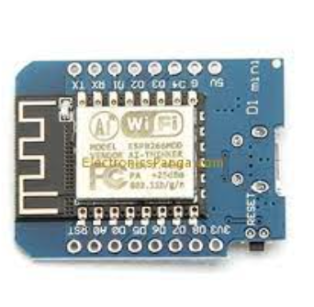
ESP8266 MOD
The ESP8266 module enables microcontrollers to connect to 2.4 GHz Wi-Fi, using IEEE 802.11 bgn

Slide 11
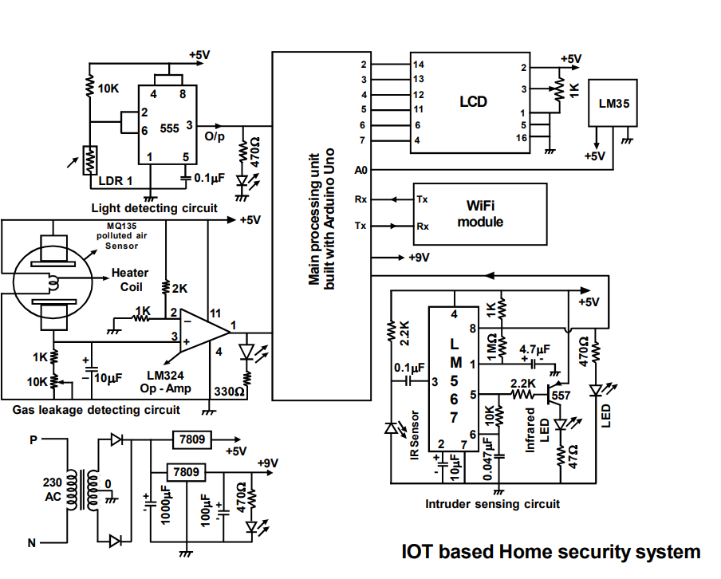
CIRCUIT DIAGRAM

